Slide 1
MONITORING PERACETIC ACID

Slide 2
Presentation to National Chicken Council November 7, 2018

Slide 3
Presented by Interscan Corporation

Slide 4
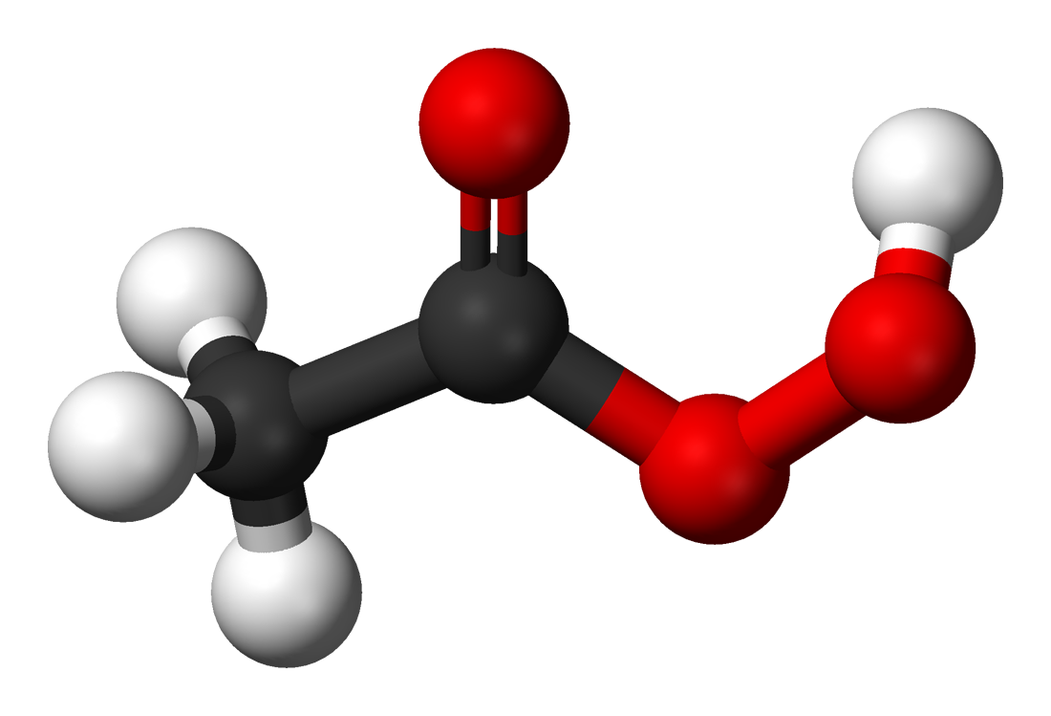
Peracetic Acid
aka Peroxyacetic Acid
aka Ethaneperoxoic Acid
aka PAA

Slide 5
History

Slide 6
PAA first registered in the U.S. as a pesticide for use as a disinfectant, sanitizer, and sterilant in 1985.
FDA approved for direct contact with food, food processing equipment and utensils, and other food contact surfaces (21 C.F.R. § 178.1010,
April 1, 2011

Slide 7
Occupational Health Considerations

Slide 8
OSHA—No PEL, but other standards do exist. Thus, agency has issued Rapid Response letters and citations under the General Duty Clause, for what it deems to be high exposures.
ACGIH TLV—0.4 ppm as a 15-min STEL
Cal/OSHA—Proposed: 0.15 ppm (8 hr TWA); 0.4 ppm (15 min STEL)
NIOSH—No REL, but proposed IDLH of 0.64 ppm

Slide 9
Chemical Properties

Slide 10
Anhydrous peracetic acid explodes violently upon heating
PAA sanitizers created by combining aqueous acetic acid and hydrogen peroxide
Equilibrates to solution containing peracetic acid, acetic acid, and hydrogen peroxide
Breaks down rapidly in air

Slide 11
Gas Detection Challenges

Slide 12
PAA unstable in air, so calibration standard must be generated on-the-fly
This stream must then be analyzed using wet chemistry
DPD (N, N-diethyl-p-phenylenediamine) method: PAA oxidizes
iodide to iodine; iodine oxidizes DPD forming pink product
Now, you have a standardized calibration source;
good for two hours

Slide 13
True field calibration is impractical— but a good PAA bump test can be supplied
A suitable PAA solution, activated with a bubbler generates a
gas stream. User refers to calibration chart, by temperature
and flow rate.
Best solution is our SENSOR EXPRESS® program
Pre-calibrated sensors are delivered to user on a scheduled
basis. Nothing to send back to factory.

Slide 14
Products

Slide 15
Portable Survey Monitors
All featuring reliable sample-draw pump

Slide 17
Single Point
Continuous Monitoring
Systems
Designed for heavy-duty industrial applications;
Sample-draw pump

Slide 18
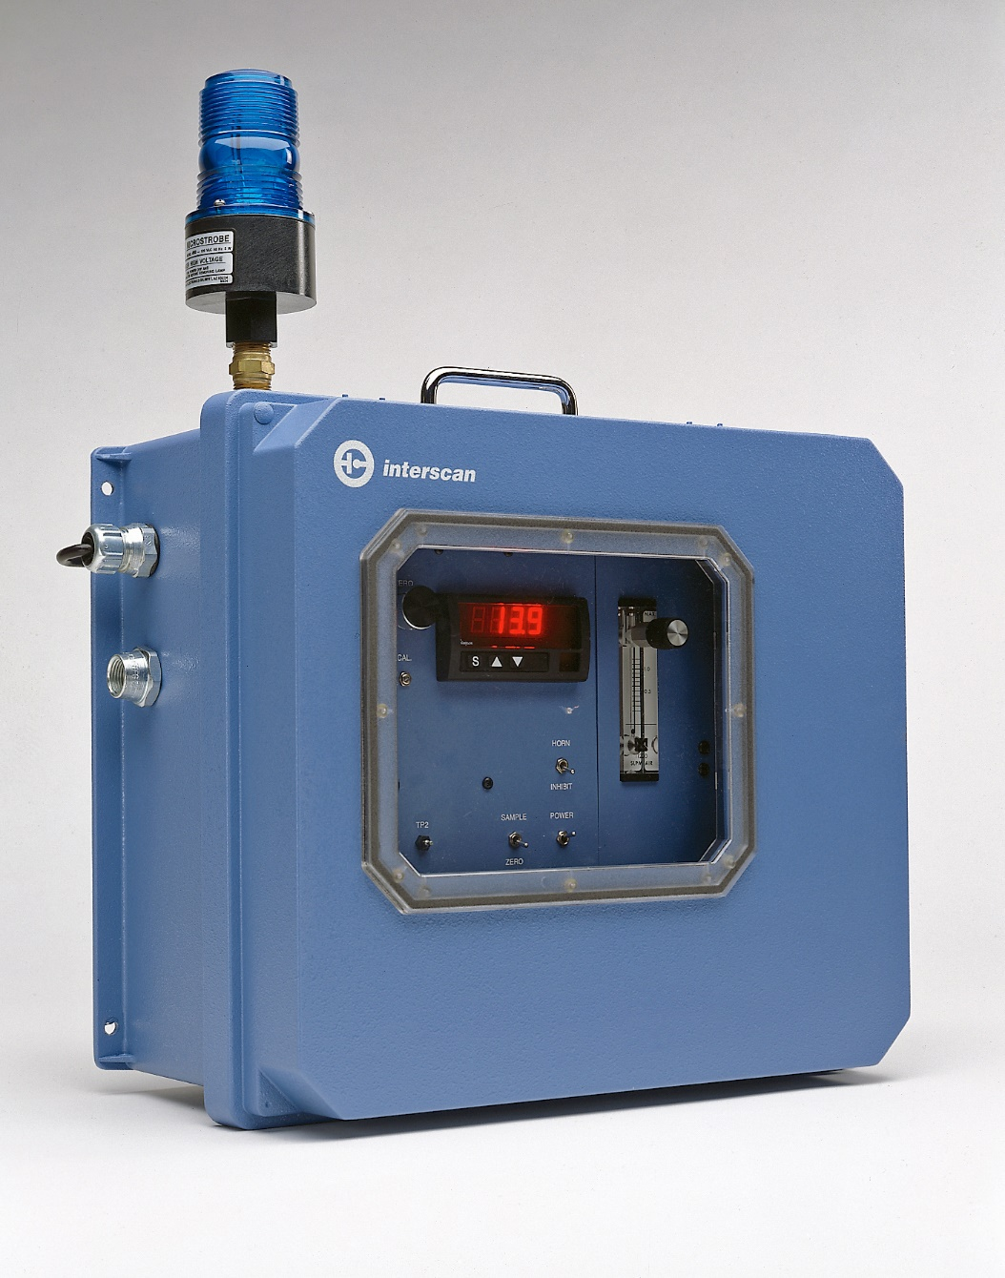

Slide 19
Multi-Point
Continuous Monitoring
Systems
Featuring the best in
factory automation

Slide 20
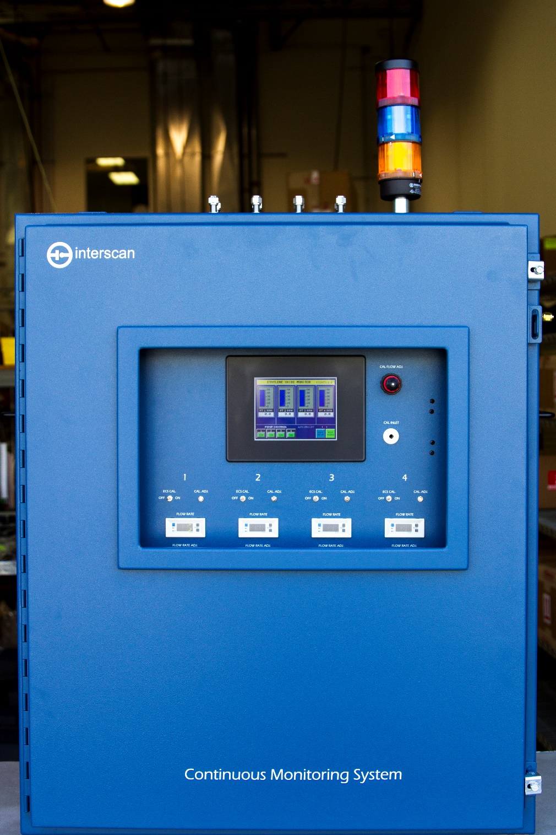

Slide 21
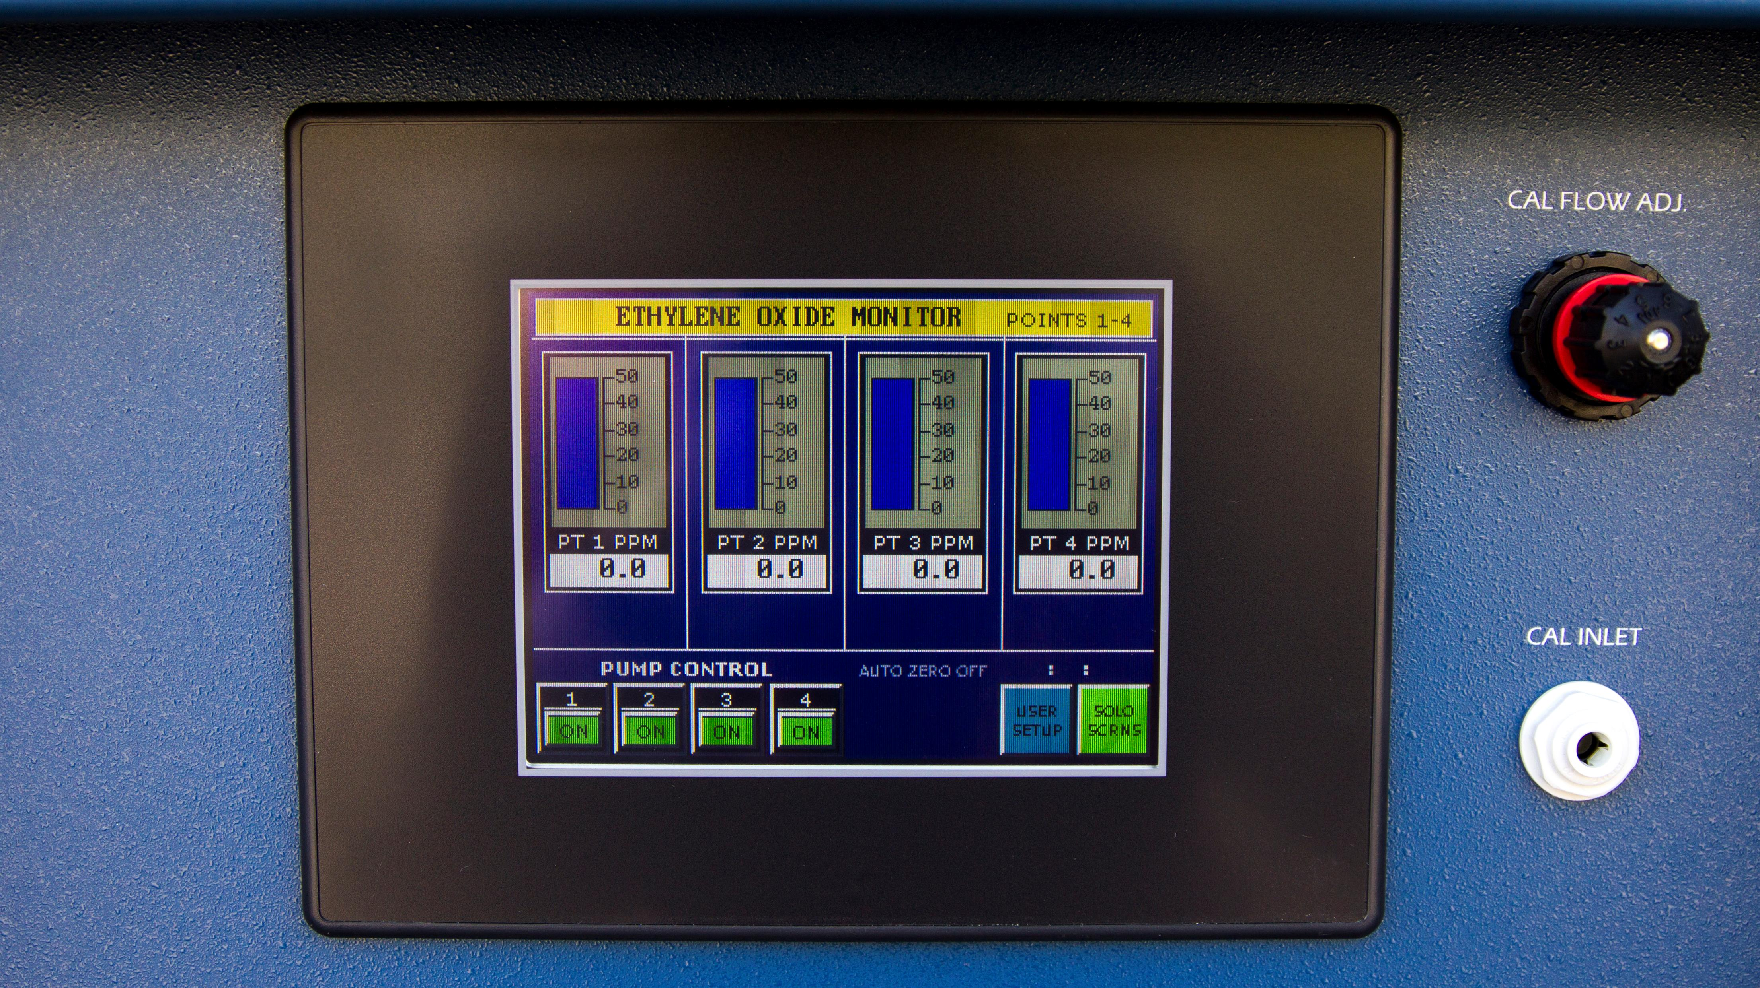

Slide 22
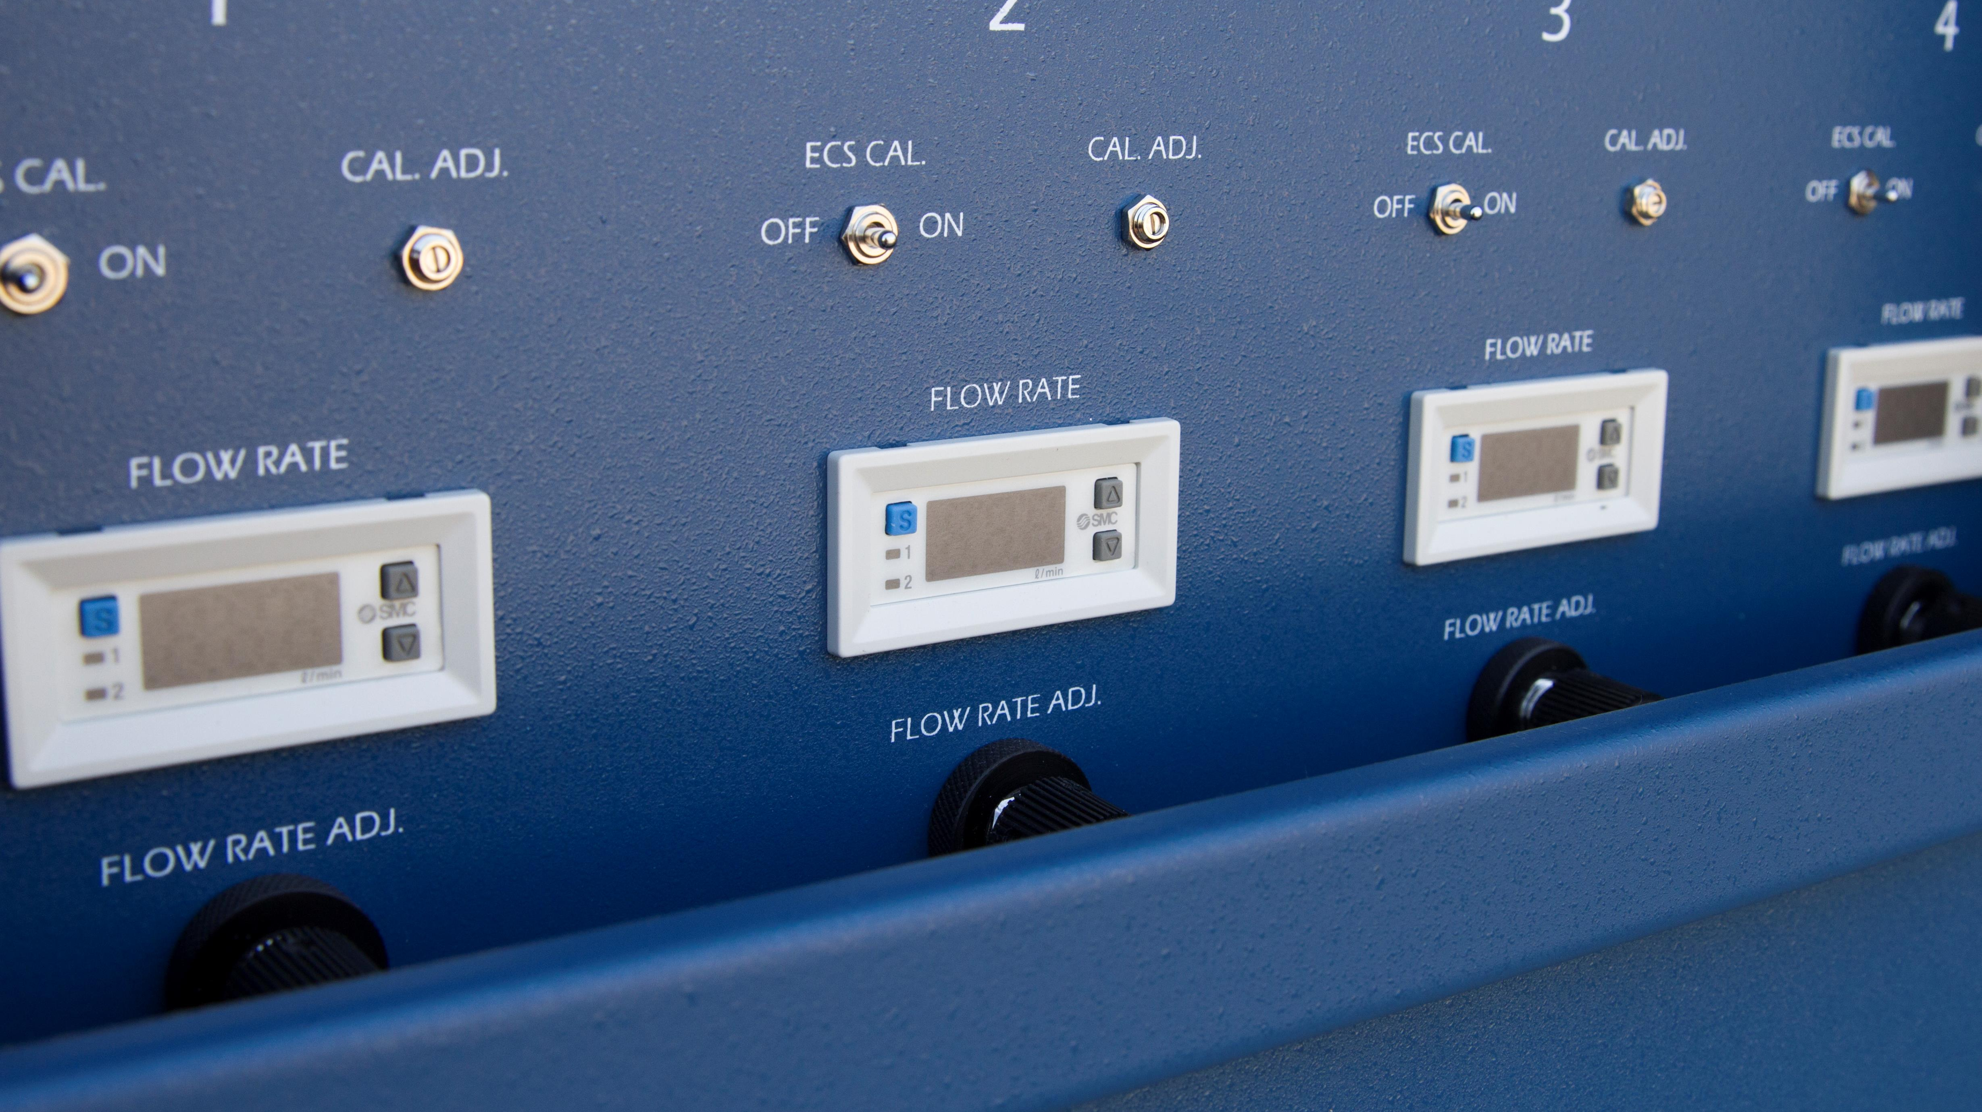

Slide 23
Arc-Max®
Data Acquisition / Logging / Archiving / Reporting System

Slide 24
Features Shift Reports, supporting up to four shifts, which can overlap
Instantaneous reading at all points
Shift Minimum and Maximum values
Alarm indication and alarm logs

Slide 25
8 hour time-weighted average—all points
The four highest 15-minute average exposures that occurred during the shift (STEL)
Live and historic trending
Web-based application coming soon

Slide 26
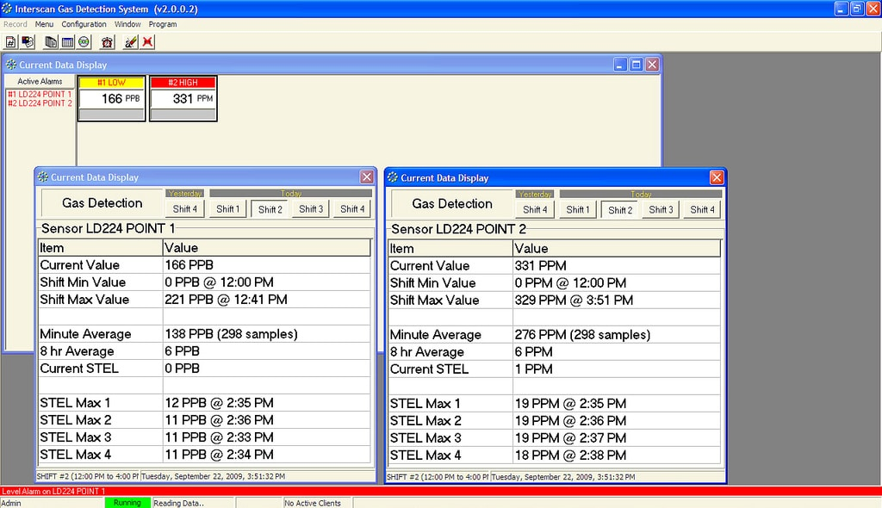

Slide 27
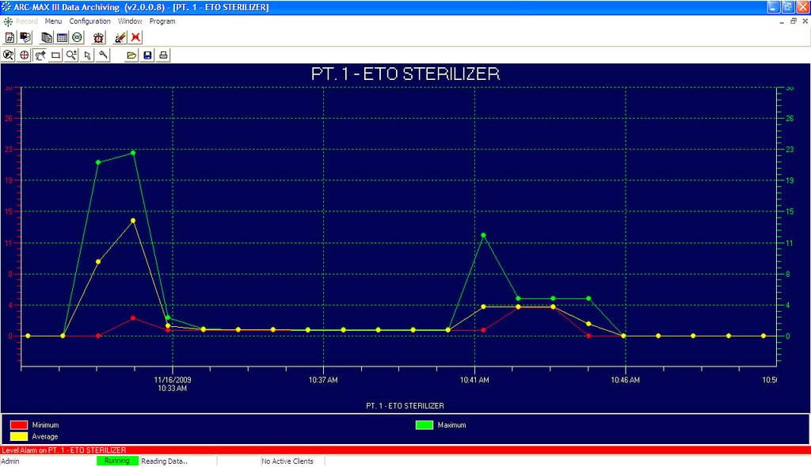

Slide 28
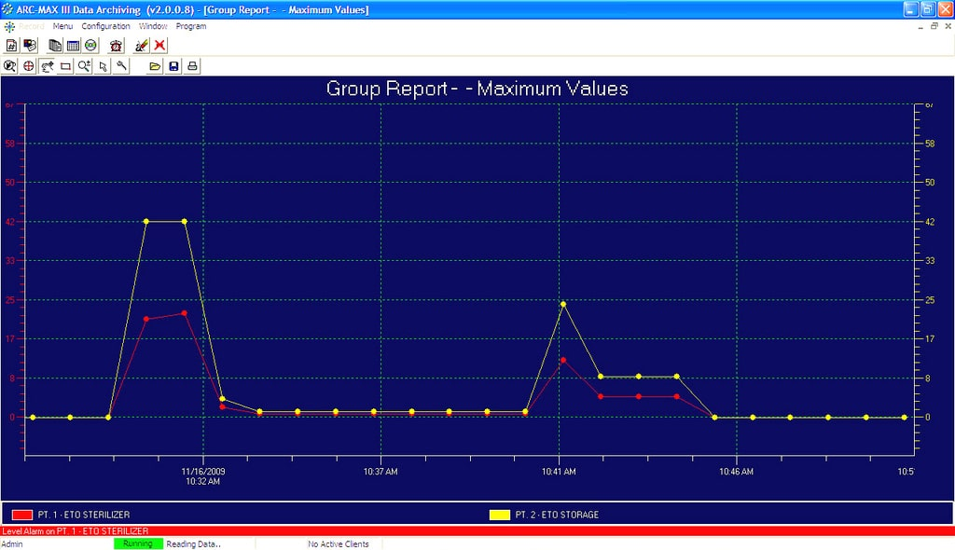

Slide 29
Interscan...
Solving gas detection
problems since 1975
Well-known for
getting it done in the
toughest applications

Slide 30
Special thanks
to
Ashley Peterson

